Slide 1
CSC431 OBJECT ORIENTED PROGRAMMING USING JAVA

Slide 2
Syllabus
Unit 1
Introduction to OOPs & Java
OOPs Concept, Java operators, Data types
Unit 2
Classes and String Handling
Unit 3
Arrays and Inheritance
Unit 4
Exception Handling and Multithreading
Unit 5
IO Packages

Slide 3
Why Java
Still world wide most popular programming language
Android apps are based on Java
90 percent of Fortune 500 companies use Java
Big Data

Slide 4
Java
Java is a general-purpose computer-programming language that is concurrent, class-based, object-oriented.

Slide 5
Advantages
Object Oriented Programming Language
Platform Independent
Rich APIs
Open Source Libraries
Secure
Multithreaded
Distributed

Slide 6
Google Classroom code
aop9qe

Slide 7
Java Program Structure
Documentation Section
Package Statement
Import Statements
Interface Statements
Class Definitions
Main Method class { Main method definition }

Slide 8
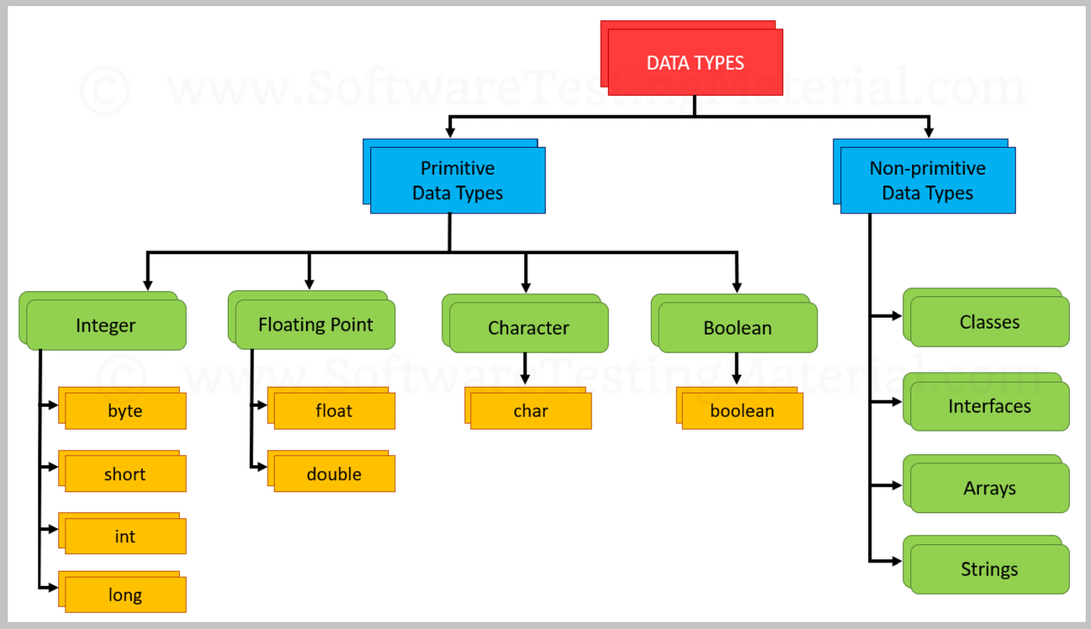

Slide 9
Size and Range : Integers
size min max
byte one byte -128 127
b) short Two bytes -32,768 32,767
c) int Four bytes -2,147,483,648 2,147,483,647
d) long Eight bytes -9,223,372,036,854,775,808
9,223,372,036,854,775,807

Slide 10
Size and Range : Floating
size min max
a) float Four bytes 3.4e-038 3.4e+038
double Eight bytes 1.7e-308 1.7e+308
All mathematical functions such as sin, cos, sqrt return double type values
char : two bytes, can hold only single character
boolean: uses one bit of storage

Slide 11
Tokens
Smallest individual units in a program are known as tokens
Java program is a collection of tokens, comments and white spaces
Java tokens
1) Reserved Keywords
2) Identifiers
3) Literals
4) Operators
5) Separators

Slide 12
Identifiers
Identifiers :
* Programmer designed tokens
* Used for naming classes, methods, variables,
objects, labels, packages, and interfaces
Rules
They can have alphabets, digits, and the underscore and dollar sign characters
They must not begin with a digit
Uppercase and lowercase letters are distinct
They can be of any length

Slide 13
Identifiers
Identifiers :
* Must be Meaningful
* Short enough to be quickly and easily typed
* Long enough to be descriptive and easily read
Naming Conventions
Names of all public methods and instance variables start with a leading lowercase letter
e.g. sum, average
When more than one words are used in a name, the second and subsequent words are marked with a leading uppercase letters
e.g. dayTemparature, firstDayOfMonth
totalMarks

Slide 14
Naming Conventions
3) All private and local variables use only lowercase letters
combined with underscores.
e.g : marks
total_marks
4) All classes and interfaces start with a leading uppercase
letter ( and each subsequent word with a leading uppercase
letter)
e.g. EightQueens
FirstJava
Encryption

Slide 15
Naming Conventions
5) Variables that represent constant values use all uppercase
letters and underscores between words
e.g. TOTAL
PI
PRINCIPAL_AMOUNT

Slide 16
Literals
Literals in Java are a sequences of characters (digits, letters and other characters) that represent constant values to be stored in variables
Types
Integer Literals
Floating point literals
Character literals
String literals
Boolean literals

Slide 17
Separators
Separators are symbols used to indicate where groups of code are divided and arranged
( ) Used to enclose parameters in method definition, defining precedence, surrounding cast types
{ } To define block, array initialization
[ ] Used to declare array types
; Used to separate statements
, Used to separate consecutive identifiers in a variable declaration and also used to chain statements together inside a for statement
. Used to separate package names from sub package and classes; also used to separate variable or method name from a reference variable

Slide 18
Type Casting and Type Conversion
Occur when there is a need to convert one data type to another.
Type conversion is done “automatically” by compiler
Type casting is to be “explicitly done” by the programmer
Example
Type Casting Type Conversion
int m=50; byte n=50;
byte n=(int)m; int m=n;

Slide 19
BASIS FOR COMPARISON | TYPE CASTING | TYPE CONVERSION
Meaning | One data type is assigned to another by the user, using a cast operator then it is called "Type Casting". | Conversion of one data type to another automatically by the compiler is called "Type Conversion".
Applied | Type casting can also be applied to two 'incompatible' data types. | Type conversion can only be implemented when two data types are 'compatible'.
Operator | For casting a data type to another, a casting operator '()' is required. | No operator required.
Size of Data Types | Destination type can be smaller than source type. | Here the destination type must be larger than source type.
Implemented | It is done during program designing. | It is done explicitly while compiling.
Conversion type | Narrowing conversion. | Widening conversion.

Slide 20
Decision Making – Branching
While
Do
For
while(test condition)
{
body of the loop
}

Slide 21
Do-While loop
do
{
body of the loop
}
while(condition)

Slide 22
For loop
for(initialization;test condition;increment)
{
}

Slide 23
Enhanced for loop
for(Type identifier : Expression)
{
statements
}

Slide 24
int numarray[5]={56,25,78,90,110};
for(int k:numarray)
{
if(k>50 && k<100)
{
System.out.println(k);
}
}

Slide 25
String states[]={”Andrapradesh”, ”Karnataka”, ”Kerala”, “Tamilnadu”,”Telengana”};
for(String st : states)
{
System.out.println(st);
}

Slide 26
Jumps in Loop
Break
To jump out of loop
Continue
Skipping a part of a loop
Labelled Loops
Loop1: for (…)
{
}

Slide 27
class continuebreak
Public static void main(String args[])
{
loop1: for(int i;=1;i<100;i++)
{
System.out.println(“ “);
if(i>=20) break;
loop2: for(int j=1; j<100;j++)
{
System.out.print(“ * “);
if(j==i)
{
continue loop2;
}
if(j>=10)
break loop1;
} } }

Slide 28
Write a program to compute the sum of the digits of a given number.
Given a number, Write a program to reverse the digits of the number .
Write a program to print the following outputs using for loops
$ $ $ $ $
$ $ $ $
$ $ $
$ $
$

